Slide 1
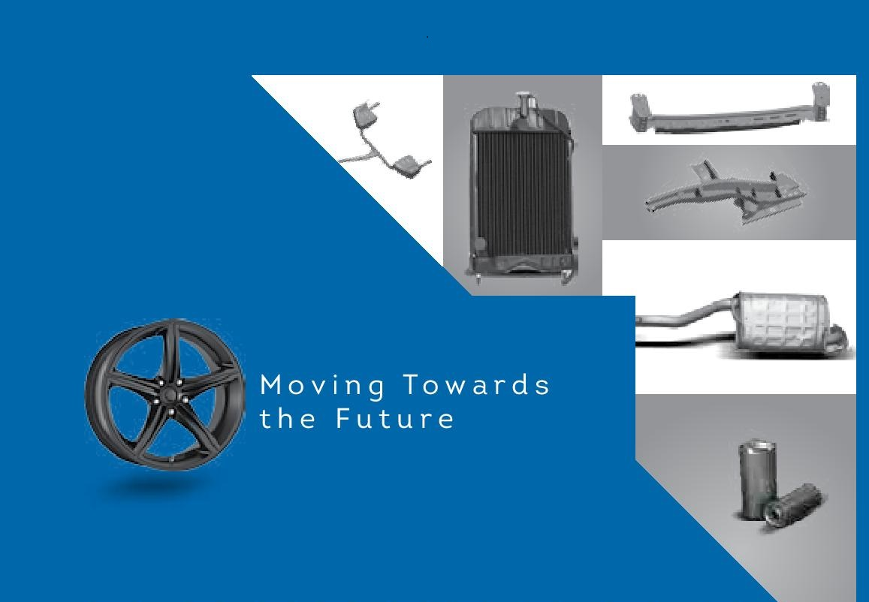
Loads Limited

Slide 2
Table of Contents
Industry Review
Turnover Analysis
Product wise Sales
Sales Breakup (OEM’s)
Inventory Trend
Borrowing Trend
New Diversification HAWL
Future Outlook
Q/A Session

Slide 3
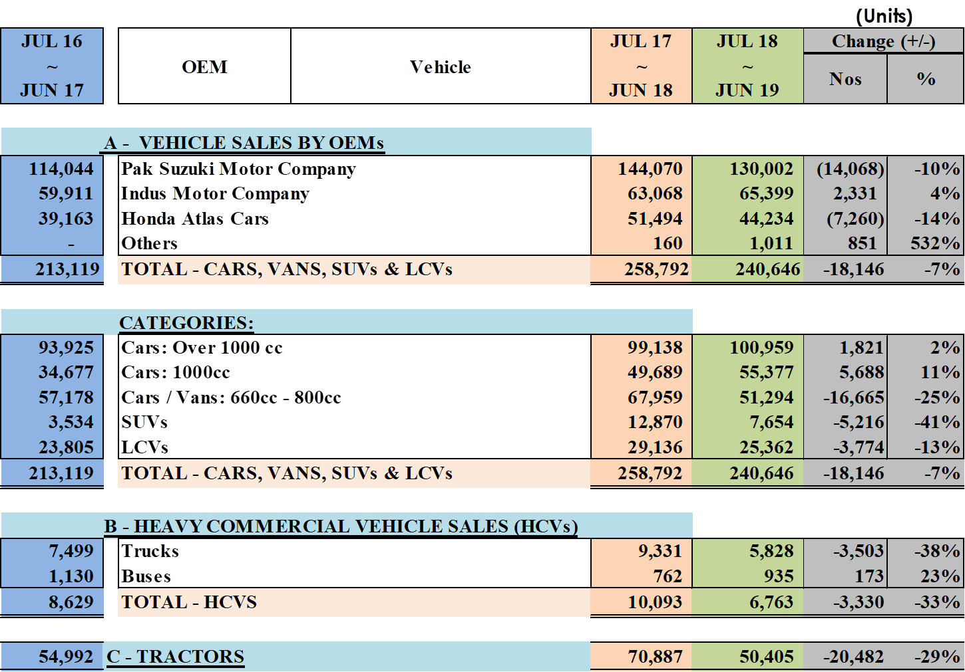
Industry Review

Slide 4
Industry Review

Slide 5
Industry Review

Slide 6
Industry Review (Jul-Sep 2019)

Slide 7
Operational Review

Slide 8
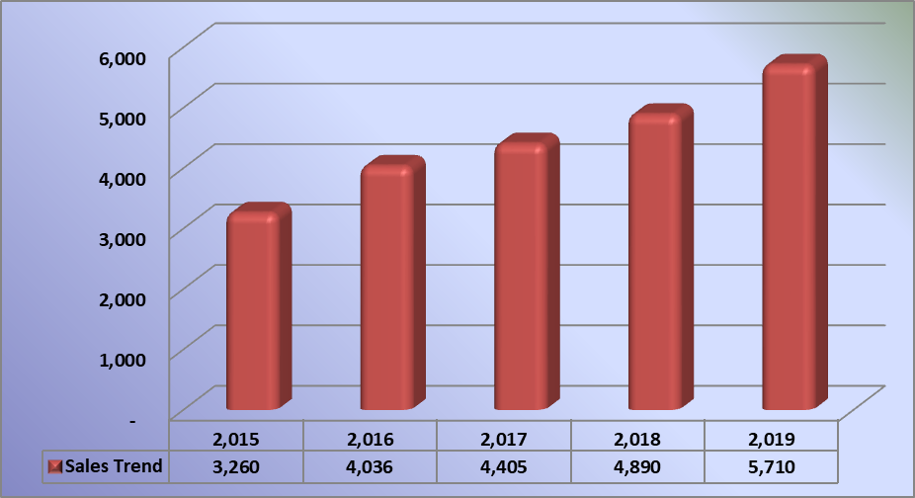
Turn Over Analysis

Slide 11
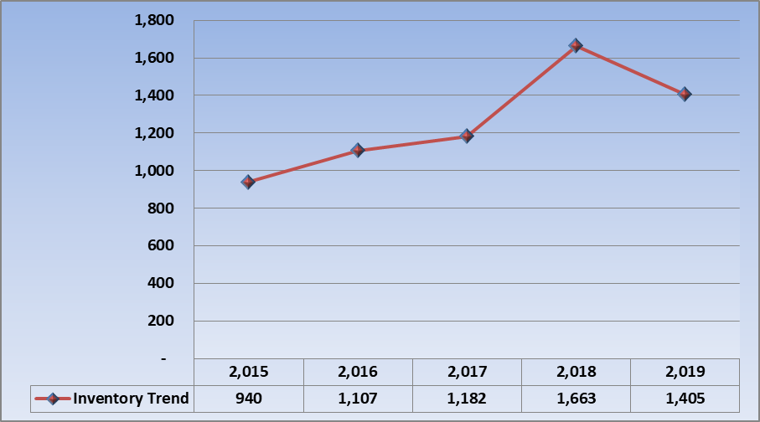
Inventory Trend

Slide 12
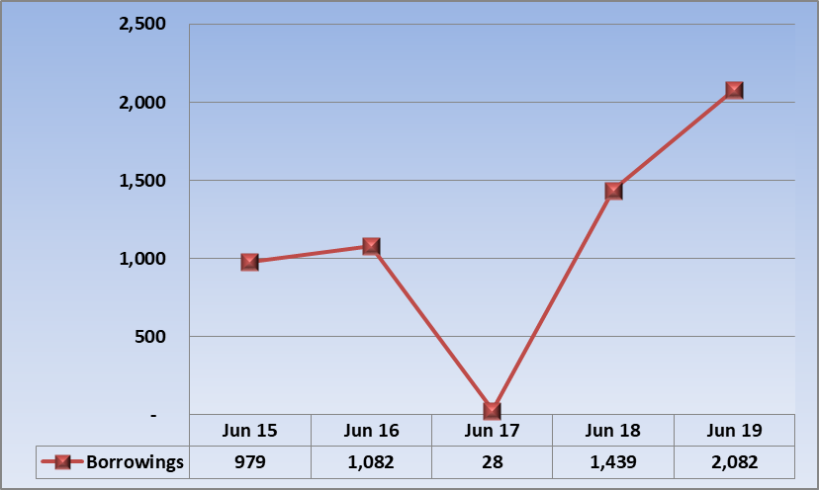
Bank Borrowing Trend

Slide 13
Diversification of Business
Hi-Tech Alloy Wheels Limited
Total Project Cost Rs. 5 billion
    Construction completed 95 %
    Installation of plant in progress 80%
    Commencement of Commercial Production 30 January 2020

Slide 14
Future Outlook
Macroeconomic indicators of the country are challenging for auto industry. Pak Rupee devaluation, rising raw material prices, increase in interest rate and additional taxes and duties imposed through Federal Budget are major challenges for auto industry. Variation in forex rates and import duties influenced the pricing of products due to element of imported components in total cost of products. The Company will focus on cost saving and consolidation to mitigate to the extent possible
The group has acquired an Australian plant which was manufacturing Alloy Wheels for Toyota Camry. This will be an addition to the group’s portfolio of auto parts products. Being the first hi-tech Alloy Wheel manufacturing facility in Pakistan, launch of this product to our existing customers as well as spare parts market will add value to the group’s business.

Slide 15
Q/A Session

Slide 16
Thanks

