Slide 1
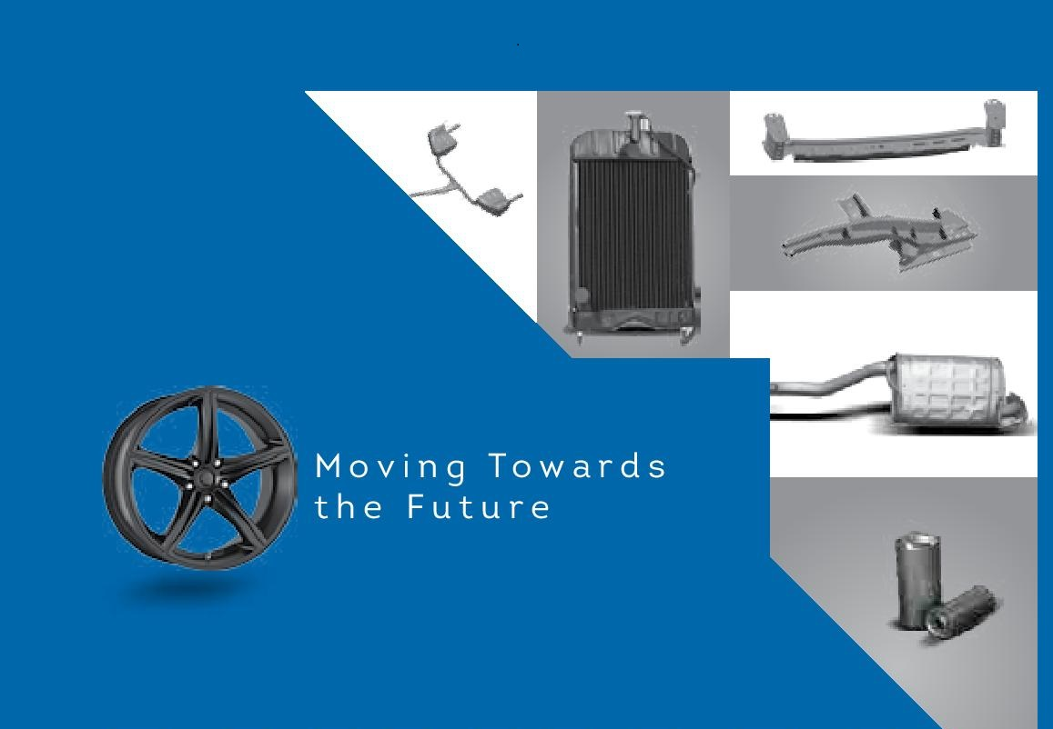
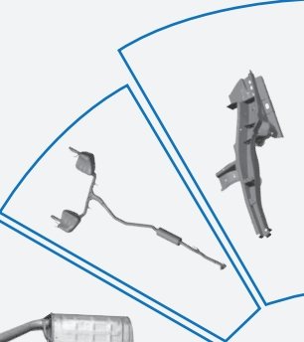
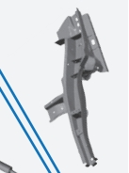
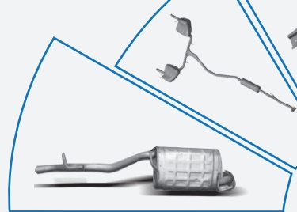

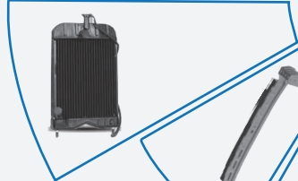

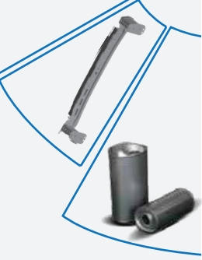
LOADS LIMITED
INNOVATION
IN MOTION
Loads Limited
Loads Limited

Slide 2
Table of Contents
Industry Review
Turnover Analysis
Product wise Sales
Sales Breakup (OEM’s)
Inventory Trend
Borrowing Trend
New Diversification HAWL
Future Outlook
Q/A Session

Slide 3
Industry Review

Slide 4
Industry Review

Slide 5
Industry Review

Slide 6
Industry Review

Slide 7
Industry Review

Slide 8
Industry Review

Slide 9
Industry Review

Slide 10
Operational Review
Rs. in Millions

Slide 11
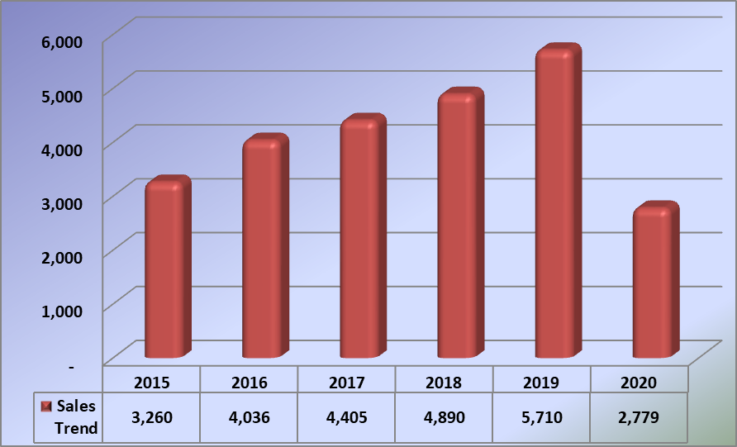
Turn Over Analysis
Rs. in Millions

Slide 12
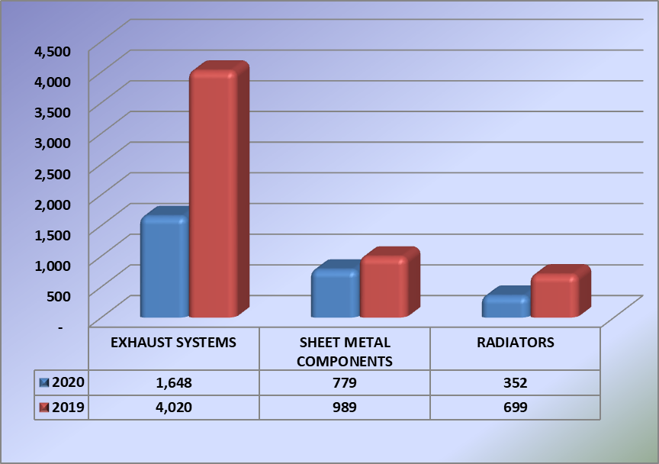
Sales Performance
Rs. in Millions

Slide 14
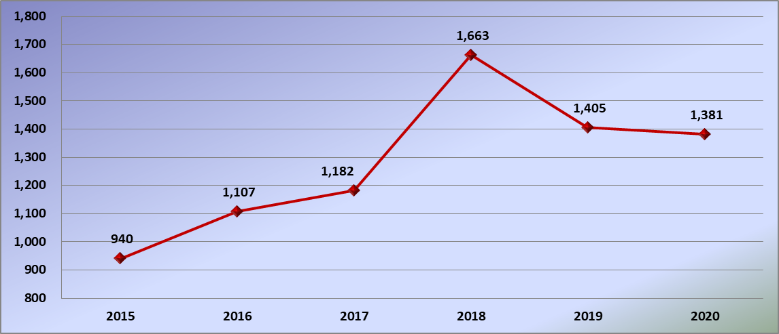
Inventory Trend
Rs. in Millions

Slide 15
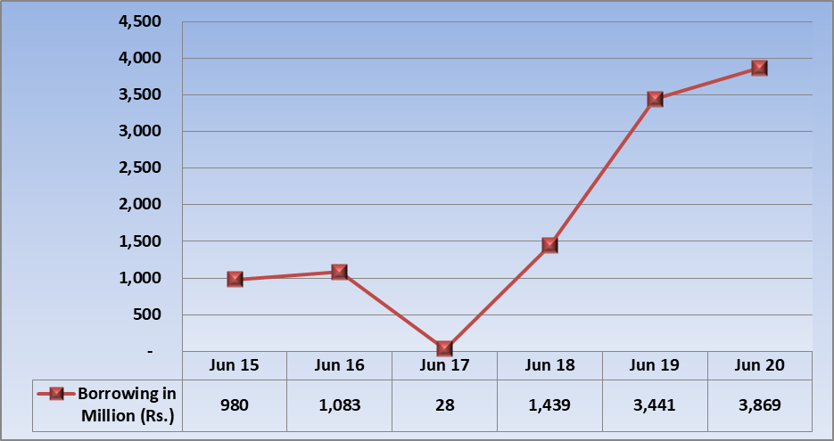
Bank Borrowing Trend
Rs. in Millions

Slide 16
Future Outlook
COVID-19 lockdowns resulted in closure of operations of all facilities from March 26, 2020 till June 4, 2020. The Government took positive steps to support the manufacturing sector to reduce the impact of Covid-19 pandemic on the economy, such as major reduction in interest rate, re-scheduling of loan installments and introduction of a refinance scheme for payment of wages and salaries. These steps have restored the operating performance of the manufacturing sector in the subsequent year.
The Company remains strongly focused on innovations, creating a strong performance culture within the organization and capitalizing on opportunities in a challenging macroeconomic environment to improve productivity and enhance shareholders’ value. Our employees remain crucial for the continued growth of the business. New technologies are continuously evolving in the auto industry and the Company is committed to adopt innovations that can positively impact the Company’s performance.

Slide 17
Q/A Session

Slide 18
Thanks

